Slide 1
BI Analysis (Partner Business Modeling: Uber)
Shawna Tuli (Shawna.tuli@avanade.com)

Slide 2
Agenda
introductions
Project
expectations
timeline
Deliverables
solution

Slide 3
Introductions

Slide 4
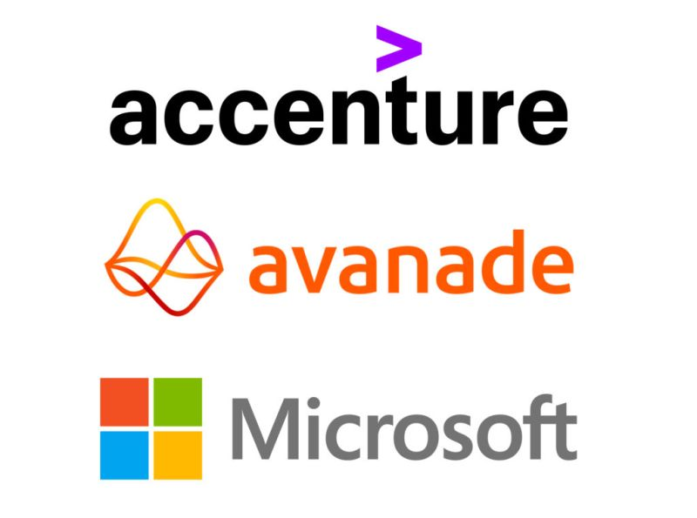
Shawna Tuli
AI & Advanced Analytics Associate Manager at Avanade (Accenture & Microsoft) San Francisco & Mountain View
UCI ICS Data Science Alumna

Slide 5

UCI Team
Andrew Hahm (hahma1@uci.edu)
Amber Jiang (yuej18@uci.edu)
Gary Zeng (zengg4@uci.edu)
Harita Kalvai (hkalvai@uci.edu)
Evan Ronald Garcia Lopez (evanrg2@uci.edu)

Slide 6

Project
Uber Data science recruitment

Slide 7
Scenario 1: It is going to be a huge Saturday and there will need to be many more cars on the road than last week. In order to get drivers to go online, we're assessing the following two bonus options in terms of cost: Option 1: $50 for each driver that is online at least 8 hours, accepts 90% of requests, completes 10 trips, and has a rating of 4.7 or better during the time frame; Option 2: $4/trip for all drivers who complete 12 trips, and have a 4.7 or better rating.
How much would the total bonus payout be with Option 1?
How many drivers would qualify for a bonus under Option 1 but not under Option 2?
What percentages of drivers online completed less than 10 trips, had an acceptance rate of less than 90%, and had a rating of 4.7 or higher?
How much would the total bonus payout be with Option 2?
Q1
Q2
Q3
Q4

Slide 8
Scenario 2: A taxi driver currently generates $200 per day in fares (before expenses), works six days a week, takes three weeks off, and has the following expenses: Gas - $200 per week Insurance - $400 per month Vehicle rent (by the week) - $500 The driver doesn't pay gas and rent expenses on off weeks. Now, let's assume that the same driver would buy a Town Car and partner with Uber. If he does, his gas expenses would go up by 5%, his insurance expense would decrease by 20%, and he would no longer be renting a vehicle. However, he would need to buy a car. The driver would still take three weeks off per year.
How much money (after expenses) does the taxi driver make per year without partnering with Uber?
You are convincing the same driver above to buy a Town Car and partner with Uber. Assuming the new car is 40,000 USD, how much would the driver's gross fares need to increase per week to fully pay for the car in year 1 and maintain the same yearly profit margin as before?
Q5
Q6

Slide 9
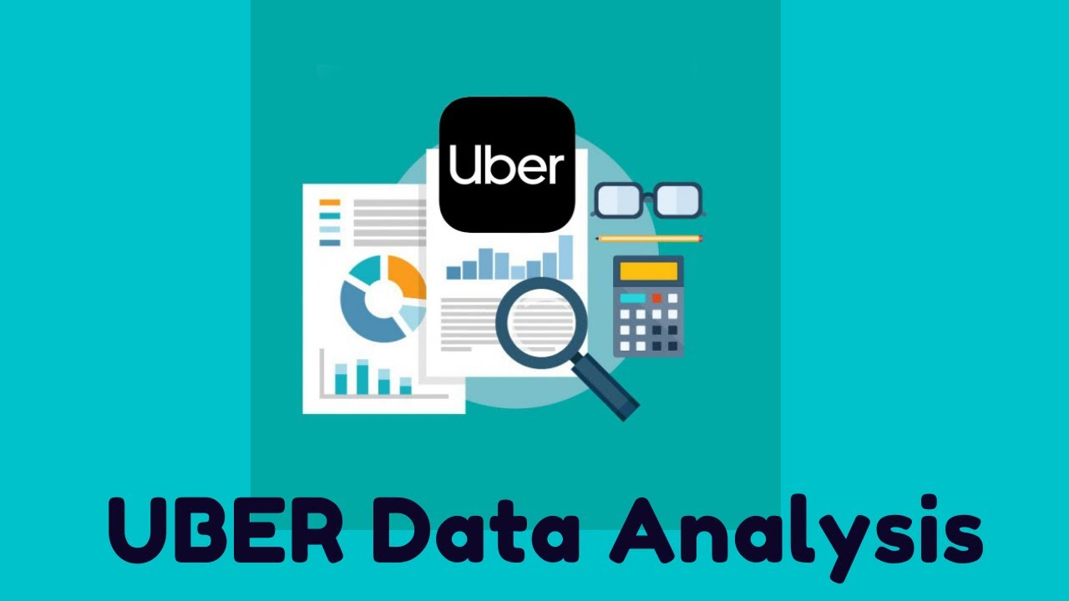
Data Description
Dataset is only used to answer Q1-Q4.
The dataset is given in the file dataset_2.csv. The data come from rides on a busy Saturday and are aggregated on a driver level. The dataset provides information on the total number of completed trips, the driver's acceptance rate, the total number of hours on duty, and the average rating.

Slide 10

Expectations

Slide 11
Expectations for Mentors
~1 hour per week.
Meet with team over Teams.
Provide guidance on project organization (ie. first steps, suggested tools) as well as the technical aspects (i.e. what specific libraries are available, which machine learning algorithms mentees could use).

Slide 12
Expectations for Mentees
4+ hours per week dedicated to the project/workshop attendance.
Take the initiative to learn new tools and research new methods.
Organize team structure and manage project’s progress (i.e. decide on meeting times to work on the project and meet with mentor).
Work with team members to overcome challenges (i.e. debugging).
Collaborate with team members effectively.

Slide 13
Timeline

Slide 14
Program
Kick-Off
Students will meet their teams and begin planning their project.
4 Workshops
Students will attend guided workshops covering key tools used in data science projects.
Help Sessions
Data@UCI will provide mini help sessions following the end each workshop.
Final Presentations
Groups will have the opportunity to present their projects and win prizes.

Slide 15
Week | Timeline
Week 1 (1/6-1/12) | Regular Event: Info Session for Mentees
Week 2 (1/13 - 1/19) | Regular Event : Project Kick-Off
Week 3 (1/20 - 1/26) | Thursday - Workshop 1: Tour of Notebooks/Environments/IDEs + Help Session
Week 4 (1/27-2/2) | Thursday - Workshop 2: Data Exploration (Pandas & Feature Selection) + Help Session
Week 5 (2/3 - 2/9) | Thursday - Workshop 3: Machine Learning (Scikit-Learn & Model Evaluation) + Help Session
Week 6 (2/10 - 2/16) | Thursday - Collaboration with Design@UCI (tentative + midterms)
Week 7 (2/17 - 2/21) | Thursday - Workshop 4: Data Visualization (Power BI or similar) + Help Session
Week 8 (2/24 - 3/1) | Thursday - Final Winter Project Help Session
Week 9 (3/3 - 3/9) | Thursday - Final Presentations

Slide 16
Deliverables

Slide 17
Week | Deliverable
Week 1 (1/6-1/12) | Commitment
Week 2 (1/13 - 1/19) | Meeting Series
Week 3 (1/20 - 1/26) | Jupyter Notebooks
Week 4 (1/27-2/2) | Exploratory Data Analyses
Week 5 (2/3 - 2/9) | Machine Learning
Week 6 (2/10 - 2/16) | Design
Week 7 (2/17 - 2/21) | Data Visualization
Week 8 (2/24 - 3/1) | Presentation
Week 9 (3/3 - 3/9) | Final Presentation

Slide 18

Solution
Stratascratch solution

Slide 19
Exploratory Data Analysis For An Uber Python Data Science Project [Part 1]
https://www.youtube.com/watch?v=ZOthTms86Bw&t=0s
In this video, we'll take you through a data project from Uber called "Partner Business Modeling". We'll delve into the details of exploring and cleaning up the dataset. We'll use popular Python libraries such as Pandas, NumPy, and Matplotlib to manipulate, analyze and visualize the data. And showcase how custom functions can be used to create bar graphs and how to clean and change rows using the apply method.

Slide 20
Using Python Pandas To Answer Business Questions For An Uber Data Science Project [Part 2]
https://www.youtube.com/watch?v=-Lzi4Qoy2v4&t=0s
Welcome to our latest video in the Data Project Series! In this episode, we'll dive into solving questions of Uber's "Partner Business Modeling" data project by using Python code to filter data and find the answers. Join us to discover the process and the final results of this exciting data project! Don't forget to subscribe and hit the notification bell to stay updated on our latest content.

Slide 21
Using Python Pandas for Building Uber's Business Models [Part 3]
https://www.youtube.com/watch?v=xlppLbv7nb0&t=0s
Welcome to the final episode in our Uber Data Science Project Series! In this video, we dive into solving Uber's "Partner Business Modeling" data project using Python to filter data and find the answers. Specifically, we tackle scenario two, where we calculate the net earnings per year of a taxi driver who generates $200 per day before expenses. We also calculate how much the driver's gross fares need to increase per week to fully pay for a $40,000 car and maintain the same yearly profit as before, assuming the driver partners with Uber. Join us as we walk you through the process and share the exciting final results of this data project. Don't forget to subscribe and hit the notification bell to stay updated on our latest content.

Slide 22
Thank you!

